Slide 1
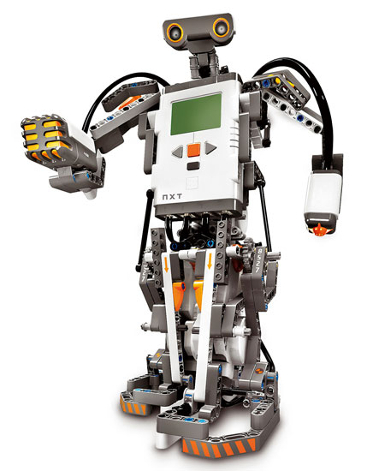
Team 8
A short intro

Slide 2
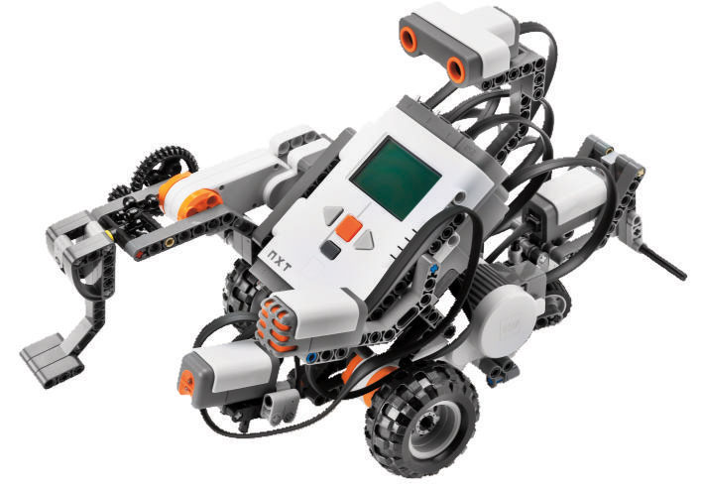
Few personal info
Names | Phone numbers | Email
Ammad Usman | 514-549-0233 | ammad.usman@mail.mcgill.ca
Baran Ureten | 514-653-8812 | baran.ureten@mail.mcgill.ca
Chowdhury Abir Hassan | 514-577-4780 | chowdhury.hassan@mail.mcgill.ca
Andrew Walker | 514-917-1857 | andrew.walker4@mail.mcgill.ca
Maxime Grégoire | 418-332-5615 | max335@hotmail.com
Dan Crisan | 514-755-2917 | dan.crisan@mail.mcgill.ca

Slide 3
Few general info
Budget
Cost budget:
Considering hardware constraints, initially, we will need a power source. We will prefer rechargeable batteries since, in the long run, it is going to cost less than buying regular batteries. In case our mechanical team requires additional equipment such as tape, or any other Lego parts that is not in the provided MindStorm Kit, we might also have to take these into consideration.
In order to meet our Software team’s requirements, we may need to purchase software testing tools.
Time Budget:
Each team member will be spending maximum 9 hours per week in the lab. If we do not face any problems, we are expecting to deliver the final product in 6 weeks.

Slide 4
Few general info
Hardware constraints
Our team only have access to 3 Mindstorm kits. Therefore, we have access to a maximum of 9 motors, 3 light sensors and 3 ultrasonic sensors. If there is a need for something that is not part of the Mindstorm kit, (such as duct tape or special claws to grab the "flag") we will first ask the permission to the client (either a professor or a teaching assistant) and then make the needed steps to get the material.

Slide 5
Gantt Chart

Slide 6
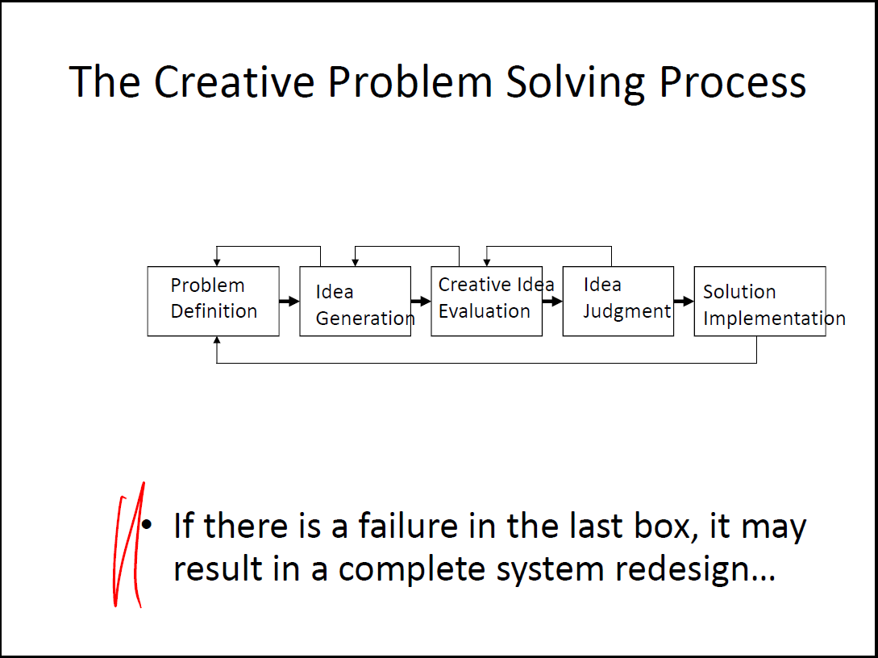

Slide 7

Questions
How will we use the Bluetooth?
Dropbox account?
Ideas?
Other…

